Slide 1
Lecture 9 - Leadership
Managing Business

Slide 2
Learning Outcomes
At the end of the lecture, you should be able to:
  Define leaders and leadership.
  Explain why managers should be leaders.
  Discuss what research has shown about leadership traits.
  Contrast the findings of the four behavioral leadership theories.

Slide 3
Leaders and Leadership
Leader – Someone who can influence others and who has managerial authority
Leadership – What leaders do; the process of influencing a group to achieve goals
Ideally, all managers should be leaders
Although groups may have informal leaders who emerge, those are not the leaders we’re studying
Leadership research has tried to answer: What is an effective leader?

Slide 4
Early Leadership Theories
Trait Theories (1920s-30s)
  Research focused on identifying personal characteristics that differentiated leaders from nonleaders was unsuccessful.
  Later research on the leadership process identified seven traits associated with successful leadership:
    Drive, the desire to lead, honesty and integrity, self-confidence, intelligence, job-relevant knowledge, and extraversion.

Slide 5
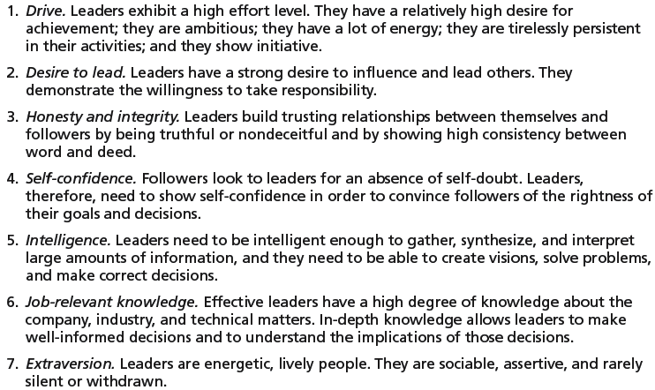
Seven Traits Associated with Leadership
Source: S. A. Kirkpatrick and E. A. Locke, “Leadership: Do Traits Really Matter?” Academy of Management Executive, May 1991, pp. 48–60; T. A. Judge, J. E. Bono, R. llies, and M. W. Gerhardt, “Personality and Leadership: A Qualitative and Quantitative Review,” Journal of Applied Psychology, August 2002, pp. 765–780.

Slide 6
Early Leadership Theories (cont’d)
Behavioral Theories
  University of Iowa Studies (Kurt Lewin)
    Identified three leadership styles:
      Autocratic style: centralised authority, low participation
      Democratic style: involvement, high participation, feedback
      Laissez faire style: hands-off management
    Research findings: mixed results
      No specific style was consistently better for producing better performance
      Employees were more satisfied under a democratic leader than an autocratic leader.

Slide 7
Early Leadership Theories (cont’d)
Behavioral Theories (cont’d)
  Ohio State Studies
    Identified two dimensions of leader behavior
      Initiating structure: the role of the leader in defining his or her role and the roles of group members
      Consideration: the leader’s mutual trust and respect for group members’ ideas and feelings.
    Research findings: mixed results
      High-high leaders generally, but not always, achieved high group task performance and satisfaction.
      Evidence indicated that situational factors appeared to strongly influence leadership effectiveness.

Slide 8
Early Leadership Theories (cont’d)
Behavioral Theories (cont’d)
  University of Michigan Studies
    Identified two dimensions of leader behavior
      Employee oriented: emphasising personal relationships
      Production oriented: emphasising task accomplishment
    Research findings:
      Leaders who are employee oriented are strongly associated with high group productivity and high job satisfaction.

Slide 9
The Managerial Grid
Managerial Grid
  Appraises leadership styles using two dimensions:
    Concern for people
    Concern for production
  Places managerial styles in five categories:
    Impoverished management
    Task management
    Middle-of-the-road management
    Country club management
    Team management

Slide 10
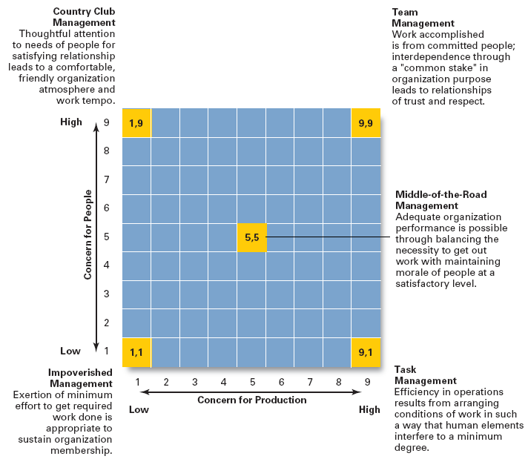
The
Managerial
Grid
Source: Reprinted by permission of Harvard Business Review. An exhibit from “Breakthrough in Organization Development” by Robert R. Blake, Jane S. Mouton, Louis B. Barnes, and Larry E. Greiner, November–December 1964, p. 136. Copyright © 1964 by the President and Fellows of Harvard College. All rights reserved.

Slide 11
Contingency Theories of Leadership
The Fiedler Model (cont’d)
  Proposes that effective group performance depends upon the proper match between the leader’s style of interacting with followers and the degree to which the situation allows the leader to control and influence.
  Assumptions:
    A certain leadership style should be most effective in different types of situations.
    Leaders do not readily change leadership styles.
      Matching the leader to the situation or changing the situation to make it favorable to the leader is required.

Slide 12
Contingency Theories… (cont’d)
The Fiedler Model (cont’d)
  Least-preferred co-worker (LPC) questionnaire
    Determines leadership style by measuring responses to 18 pairs of contrasting adjectives.
      High score: a relationship-oriented leadership style
      Low score: a task-oriented leadership style
  Situational factors in matching leader to the situation:
    Leader-member relations
    Task structure
    Position power

Slide 13
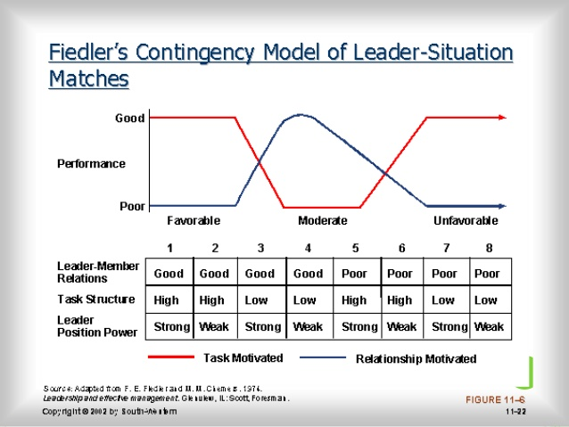

Slide 14
Contingency Theories… (cont’d)
Hersey and Blanchard’s Situational Leadership Theory (SLT)
  Argues that successful leadership is achieved by selecting the right leadership style which is contingent on the level of the followers’ readiness.
    Acceptance: leadership effectiveness depends on whether followers accept or reject a leader.
    Readiness: the extent to which followers have the ability and willingness to accomplish a specific task.
  Leaders must relinquish control over and contact with followers as they become more competent.

Slide 15
Contingency Theories… (cont’d)
Hersey and Blanchard’s Situational Leadership Theory (SLT)
  Creates four specific leadership styles incorporating Fiedler’s two leadership dimensions:
    Telling: high task-low relationship leadership
    Selling: high task-high relationship leadership
    Participating: low task-high relationship leadership
    Delegating: low task-low relationship leadership

Slide 16
Contingency Theories… (cont’d)
Leader Participation Model (Vroom and Yetton)
  Posits that leader behavior must be adjusted to reflect the task structure - whether it is routine, non-routine, or in between - based on a sequential set of rules (contingencies) for determining the form and amount of follower participation in decision making in a given situation.

Slide 17

Contingency Theories… (cont’d)
Leader Participation Model Contingencies:
  Decision significance
  Importance of commitment
  Leader expertise
  Likelihood of commitment
  Group support
  Group expertise
  Team competence

Slide 18
Leadership Styles in the Vroom Leader Participation Model
Decide: Leader makes the decision alone and either announces or sells it to group.
Consult Individually: Leader presents the problem to group members individually, gets their suggestions, and then makes the decision.
Consult Group: Leader presents the problem to group members in a meeting, gets their suggestions, and then makes the decision.
Facilitate: Leader presents the problem to the group in a meeting and, acting as facilitator, defines the problem and the boundaries within which a decision must be made.
Delegate: Leader permits the group to make the decision within prescribed limits.
Source: Based on V. Vroom, “Leadership and the Decision-Making Process,” Organizational Dynamics, vol. 28, no. 4 (2000), p. 84.

Slide 19
Contingency Theories… (cont’d)
Path-Goal Model
  States that the leader’s job is to assist his or her followers in attaining their goals and to provide direction or support to ensure their goals are compatible with organisational goals.
  Leaders assume different leadership styles at different times depending on the situation:
    Directive leader
    Supportive leader
    Participative leader
    Achievement oriented leader

Slide 20
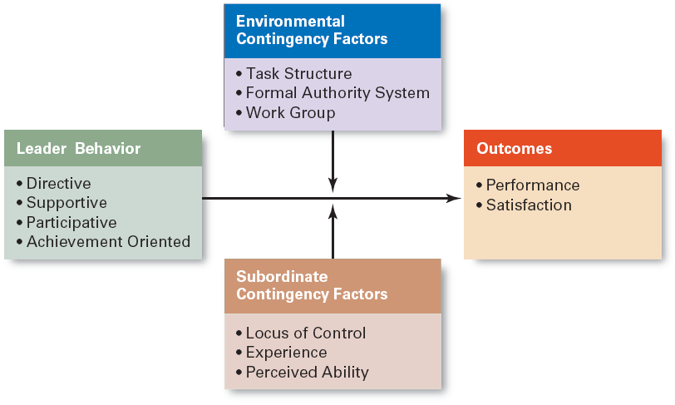
Path-Goal Theory

Slide 21

What are Teams?
Groups of two or more people
Exist to fulfill a purpose
Interdependent -- interact and influence each other
Mutually accountable for achieving common goals
Perceive themselves as a social entity
B. Matthews/AP Photo

Slide 22
Groups versus Teams
All teams are groups
Some groups are just people assembled together
Teams have task interdependence whereas some groups do not (e.g., group of employees enjoying lunch together)

Slide 23
Team Leader
Team Leadership Characteristics
  Having patience to share information
  Being able to trust others and to give up authority
  Understanding when to intervene
Team Leader’s Job
  Managing the team’s external boundary
  Facilitating the team process
    Coaching, facilitating, handling disciplinary problems, reviewing team and individual performance, training, and communication

Slide 24
Summary of Main Teaching Points
  Explain how Fiedler’s theory of leadership is a contingency model.
  Contrast situational leadership theory and the leader participation model.
  Discuss how path-goal theory explains leadership.

Slide 25
Question and Answer Session
Q & A

Slide 26
Next Session
Topic and Structure of next session
NEXT LESSON:
Control

